Slide 1


SRIB / SMART THINGS /
EDGE TEAM /
DA PLATFORM
Review 1
Manish Patil
Prasanna Manoharan
Guided By:
Inbarajan P
Vishal Bharti

Slide 2
ROS
1 | ROS is a flexible framework to build a robotic software. It provides tools and libraries to help the software developer to create robotic applications. ROS, actually not an operating system rather it is a middleware that provides services.
2 | Various Components of ROS include Nodes, Topics, Publisher, Subscriber, Services, etc.

Slide 3
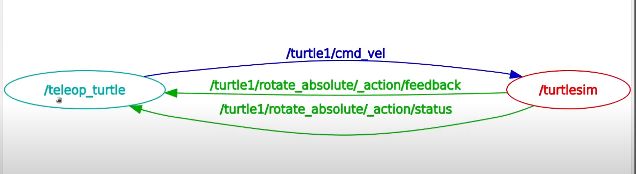
Node
1 | Each node in ROS should be responsible for a single, modular purpose,
2 | Each node can send and receive data from other nodes via topics, services, actions, or parameters.

Slide 4
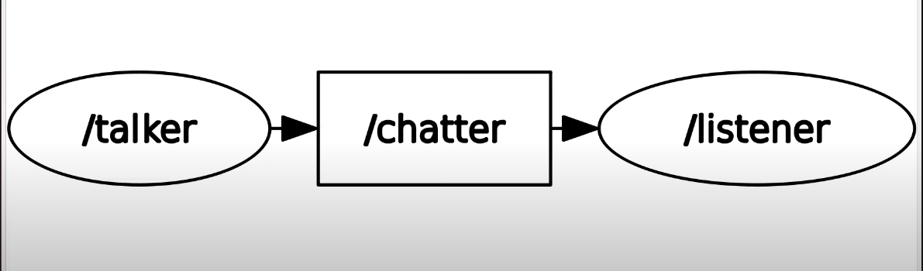
Topic
1 | Topics are a vital element of the ROS graph that act as a bus for nodes to exchange messages.
2 | A node may publish data to any number of topics and simultaneously have subscriptions to any number of topics.

Slide 5
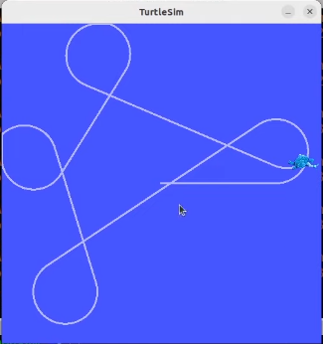
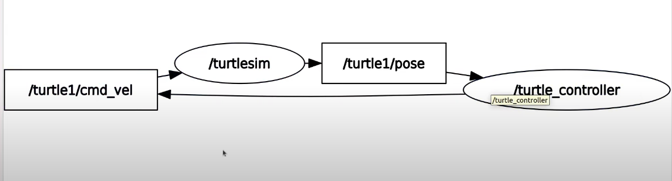
Publisher and Subscriber
1 | If a node wants to share information, it uses a publisher to send data to a topic.
2 | A node that wants to receive that information uses a subscriber to that same topic.
3 | A ROS Node can be a Publisher or a Subscriber.

Slide 6
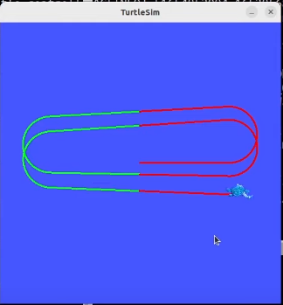
Services
1 | A service refers to a remote procedure call. In other words, a node can make a remote procedure call to another node which will do a computation and return a result.
2 | Services are based on a call-and-response model, versus topics’ publisher-subscriber model.
3 | While topics allow nodes to subscribe to data streams and get continual updates, services only provide data when they are specifically called by a client.

Slide 7
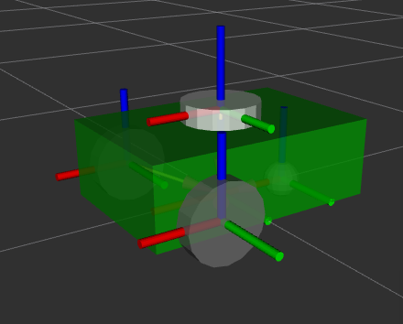
URDF
1 | URDF stands for Unified Robot Description Format, an XML format used to describe a robot's physical configuration.
2 | It is used primarily in robotics to define the kinematic and dynamic properties of a robot model.
3 | It provides a standardized way to describe robot models, ensuring compatibility across various tools and systems.
4 | Key components of URDF: Links, Joints, Robot Tag, Material

Slide 8
RViz
1 | RViz (ROS Visualization) is a 3D visualization tool for robots, sensors, and algorithms in the ROS (Robot Operating System) ecosystem.
2 | It allows developers to visualize the state of the robot and sensor data in a comprehensive and interactive way.
3 | RViz shows the configuration of joints and links, helping in debugging and verifying robot designs.
4 | It is useful for tasks like path planning, object manipulation, and environment interaction.

Slide 9
Gazebo
1 | Gazebo is a powerful open-source 3D robotics simulator used to simulate robots, sensors, and environments.
2 | It allows developers to test algorithms, design robots and perform regression testing in a highly realistic environment without the need for physical hardware.
3 | Gazebo supports dynamic changes in the environment, such as moving objects or changing weather conditions.
4 | Gazebo supports the development and integration of custom plugins to extend functionality and also allows users to add custom sensors, controllers, and other components.

Slide 10
Plugin
1 | Plugins are pieces of code that extend the functionality of a robot simulation by adding custom behaviors, sensors, controllers, or interactions.
2 | It is used to simulate the behavior of various sensors such as cameras, LiDAR, GPS & more and also it generates realistic sensor data that can be used for testing and algorithm development.
3 | It also control the actuators of the robot, such as motors, joints, and wheels.
4 | Plugins are specified in the robot’s URDF file, allowing Gazebo to load and execute them during simulation.

Slide 11
Launch File
1 | A launch file in ROS2 is a script used to start up multiple nodes and set parameters in a coordinated manner.
2 | It simplifies the process of launching a complex system by allowing users to define and manage multiple nodes, their configurations, and inter-node communication in a single file.
3 | Launch files can be written in XML or Python.
4 | It supports managing the lifecycle of nodes, including starting, stopping, and managing state transitions.

Slide 12
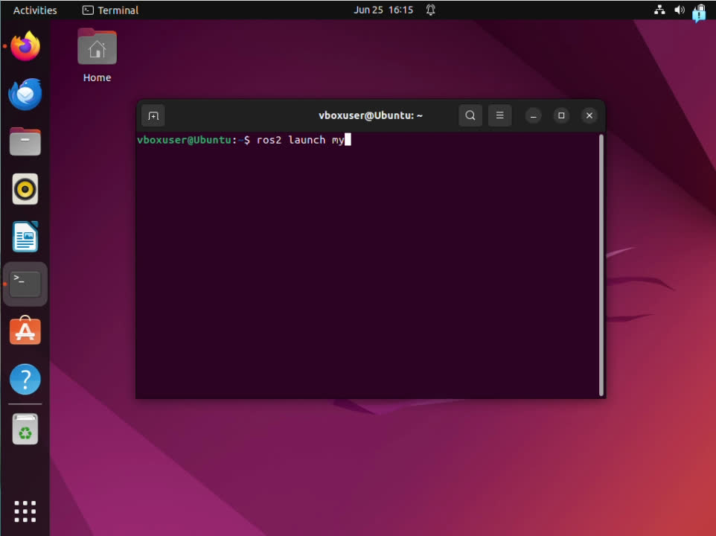
Deploying URDF file in RViz

Slide 13
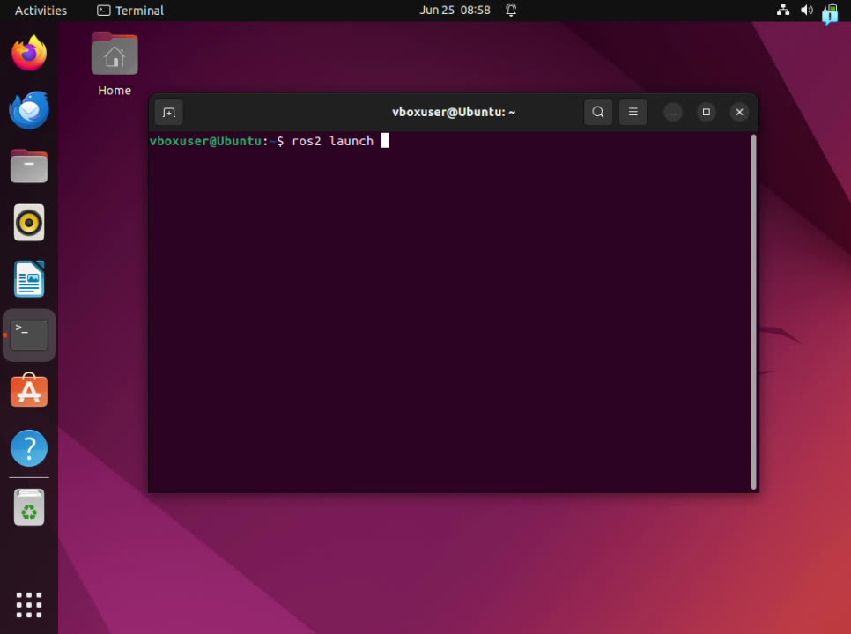
Deploying URDF file in Gazebo

